Slide 1



CONSUMER GOODS
AD – HOC INSIGHTS
Created By : Raviranjan Kumar
SQl - Project

Slide 2
Objectives
AtliQ Hardware stands out as a prominent manufacturer of computer hardware within India, boasting a robust international footprint.
Management has observed a deficiency in their ability to swiftly and intelligently make data-driven decisions. Consequently, they aim to bolster their data analytics team by recruiting multiple junior data analysts.
In order to comprehensively evaluate the suitability of Tony Sharma as a potential candidate, the Director of Data Analytics, Tony Sharma, plans to arrange an SQL challenge. This challenge will assess not only his technical proficiency but also his soft skills.
The company has pinpointed 10 specific ad hoc requests for which they are seeking valuable insights.

Slide 3
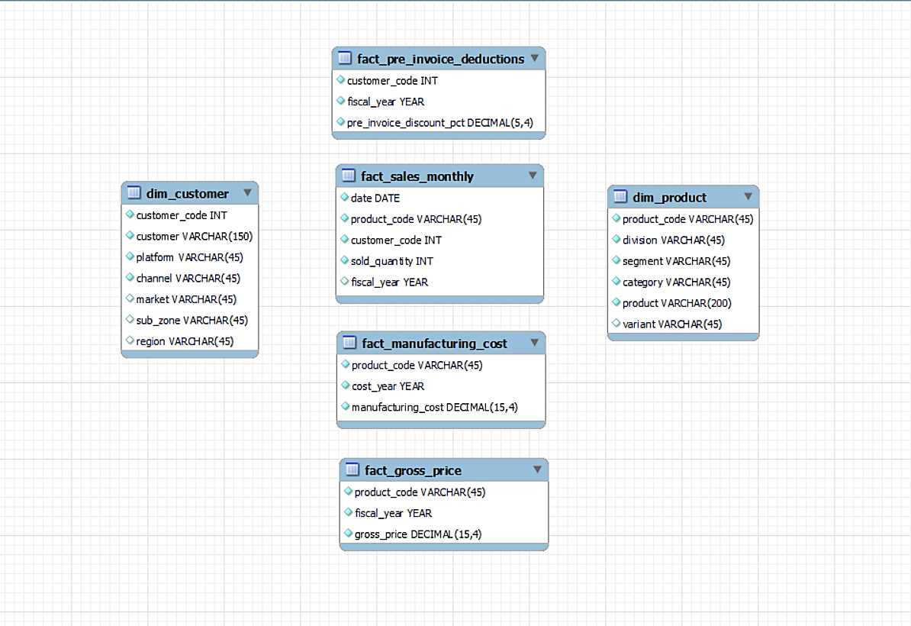
Input Data

Slide 4
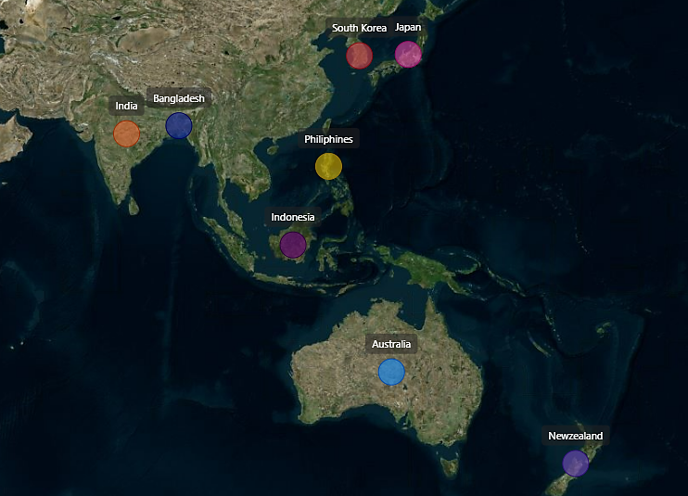
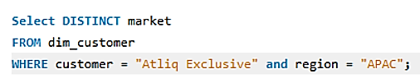
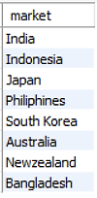
Request – 1 : Provide the list of markets in which customer "Atliq Exclusive" operates its business in the APAC region.
SQL Query
Output
"AtliQ Exclusive" has expanded its presence into 8 key markets within the Asia-Pacific (APAC) region. This is a significant achievement.

Slide 5
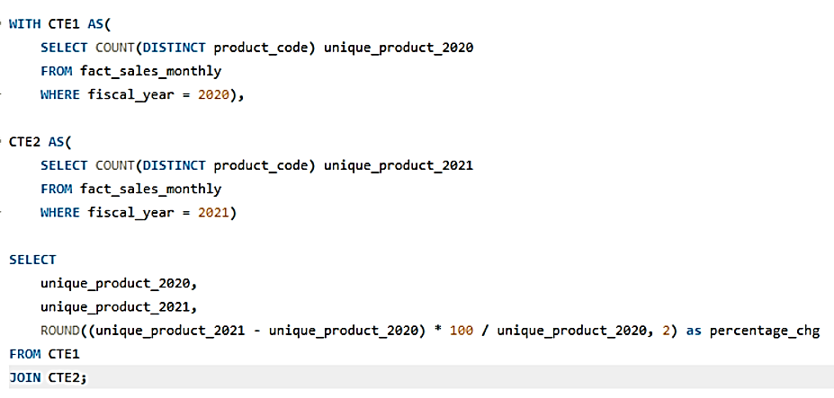
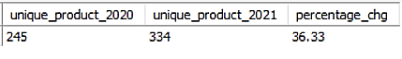
Request – 2 : What is the percentage of unique product increase in 2021 vs. 2020? The final output contains these fields,
unique_products_2020
unique_products_2021
percentage_chg
SQL Query
Output

Slide 6
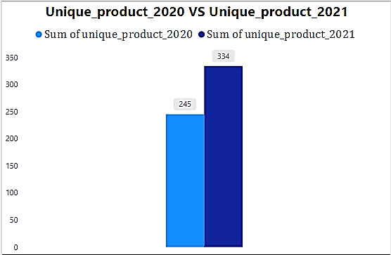
Visual and insights
We are actively showcasing continuous innovation, consistently rolling out new products. In 2020, we offered 245 products, and by 2021, that number surged by 36%, reaching a total of 334 products.

Slide 7
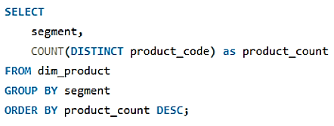
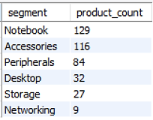
Request – 3 : Provide a report with all the unique product counts for each segment and sort them in descending order of product counts. The final output contains 2 fields,
Segment
product_count
SQL Query
Output

Slide 8
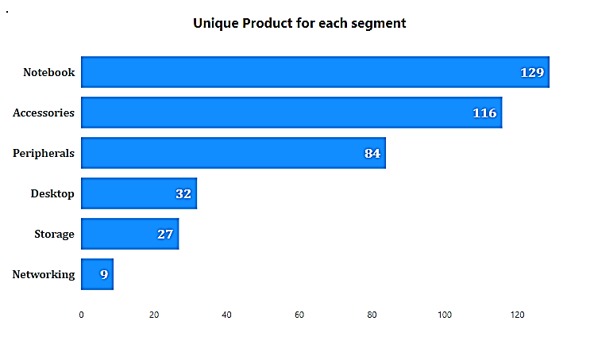
Visual and insights
Segments like Notebooks, Accessories, and Peripherals are seeing significant manufacturing growth compared to Desktop storage and networking.
Together, Notebooks, Accessories, and Peripherals constitute 83% of our manufacturing output.

Slide 9
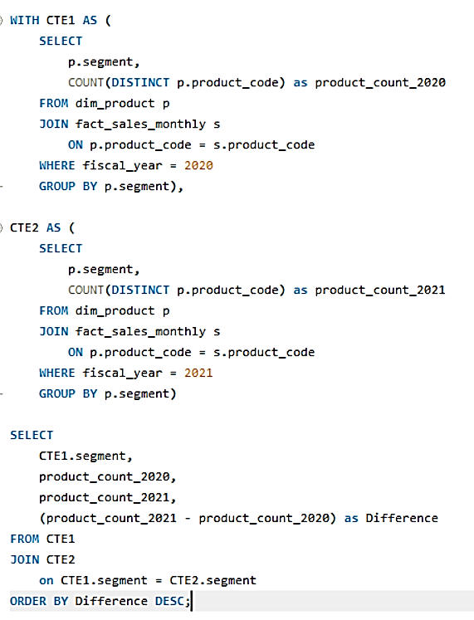
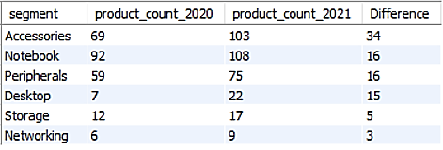
Request – 4 : Which segment had the most increase in unique products in 2021 vs 2020? The final output contains these fields,
Segment
product_count_2020
product_count_2021
difference
SQL Query
Output
Accessories saw the most significant rise in production.
Storage and Networking are undergoing slower growth compared to other segment.

Slide 10
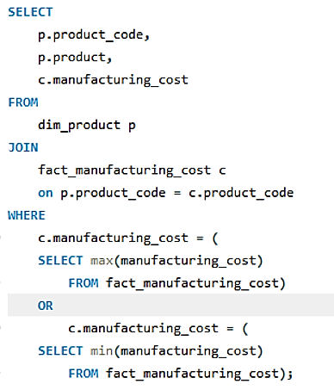
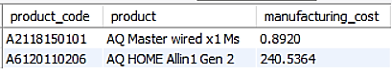
Request – 5 : Get the products that have the highest and lowest manufacturing costs. The final output should contain these fields,
product_code
Product
manufacturing_cost
SQL Query
Output
AQ HOME Allin 1 Gen 2 Personal Desktop has highest manufacturing cost.
AQ Master wired x1 Ms Mouse has the lowest manufacturing cost.

Slide 11
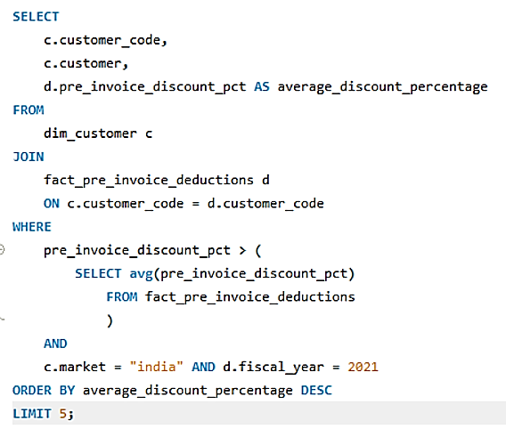
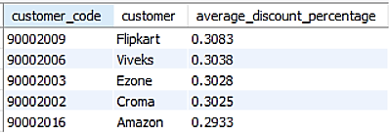
Request – 6 : Generate a report which contains the top 5 customers who received an average high pre_invoice_discount_pct for the fiscal year 2021 and in the Indian market. The final output contains these fields,
customer_code
Customer
average_discount_percentage
SQL Query
Output
Flipkart received the highest average_discount_percentage.
Amazon received the lowest average_discount_percentage.

Slide 12
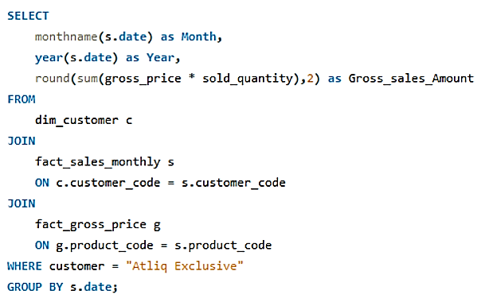
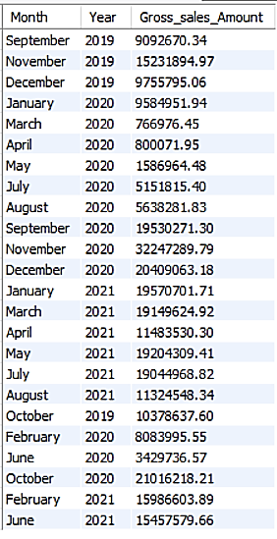
Request – 7 : Get the complete report of the Gross sales amount for the customer “Atliq Exclusive” for each month. This analysis helps to get an idea of low and high-performing months and take strategic decisions. The final report contains these columns:
Month
Year
Gross sales Amount
SQL Query
Output

Slide 13
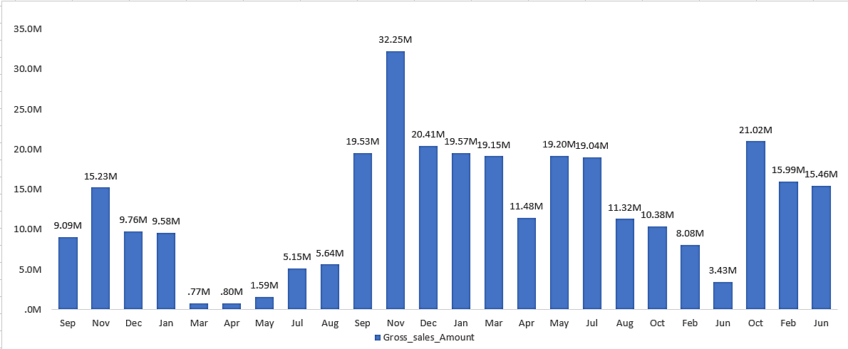
Visual and insights
AtliQ Exclusive sold the most stuff in November 2020 and Least in March 2020 .
After experiencing a decline in sales from March to August due to the impact of COVID-19, we are now seeing a positive turnaround. Sales have been steadily increasing and surpassing even our figures from 2020.

Slide 14
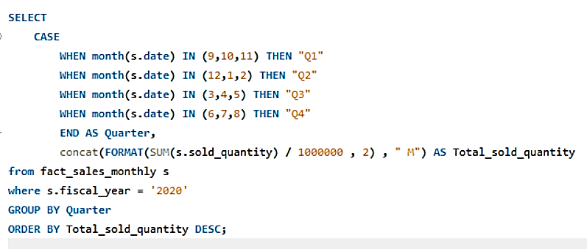
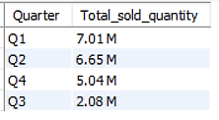
Request – 8 : In which quarter of 2020, got the maximum total_sold_quantity? The final output contains these fields sorted by the total_sold_quantity,
Quarter
total_sold_quantity
SQL Query
Output

Slide 15
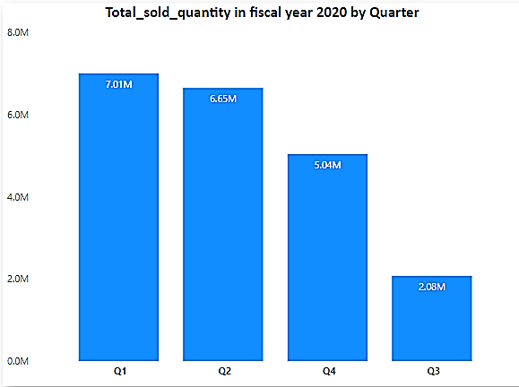
Visual and insights
Q1 of FY 2020 saw the peak in unit sales, while Q3 experienced the lowest sales.
Around 34% of the total units sold in FY 2020 were accounted for by Q1

Slide 16
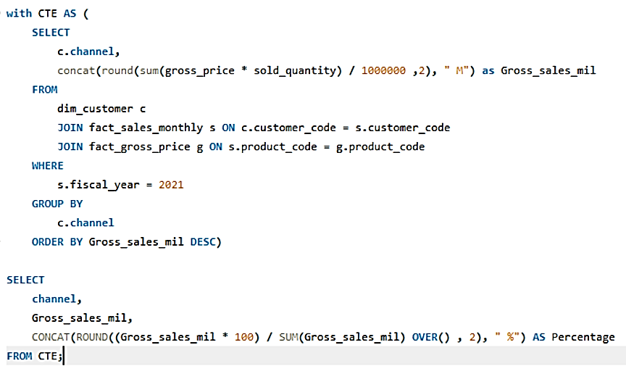
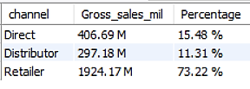
Request – 9 : Which channel helped to bring more gross sales in the fiscal year 2021 and the percentage of contribution? The final output contains these fields,
Channel
gross_sales_mln
percentage
SQL Query
Output

Slide 17
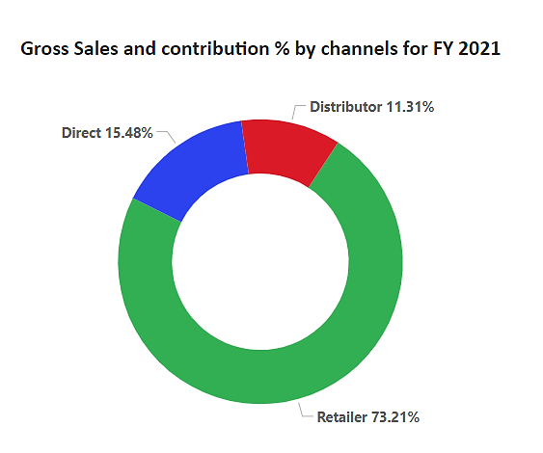
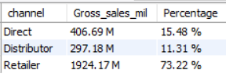
Visual and insights
Our sales were predominantly driven by retailers, accounting for 75% of the total sales, with only a small fraction attributed to distributors and direct sales channels.

Slide 18
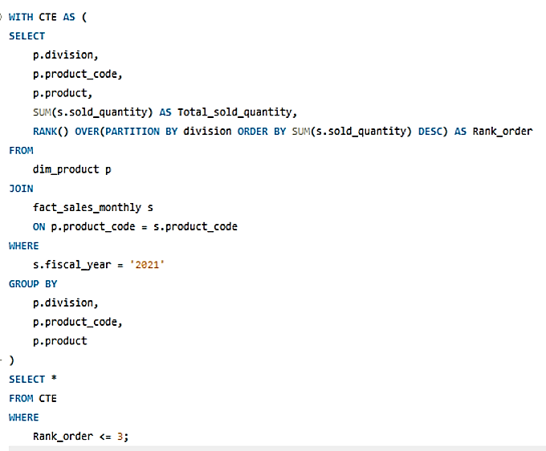
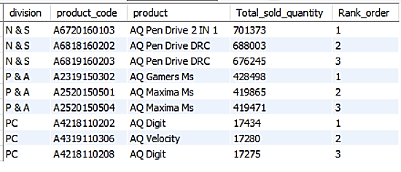
Request – 10 : Get the Top 3 products in each division that have a high total_sold_quantity in the fiscal_year 2021? The final output contains these fields,
Division
product_code
SQL Query
Output

Slide 19
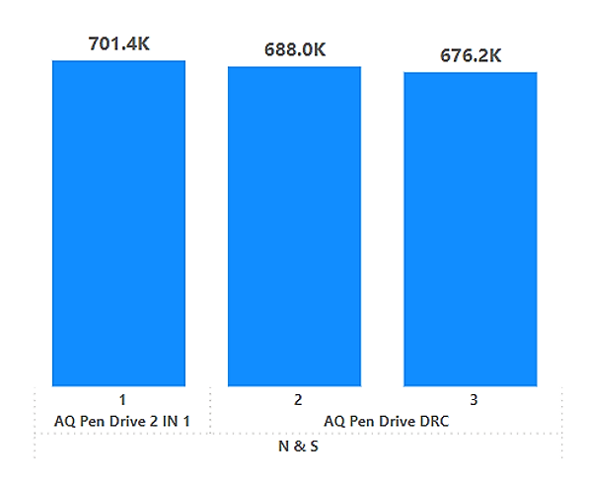
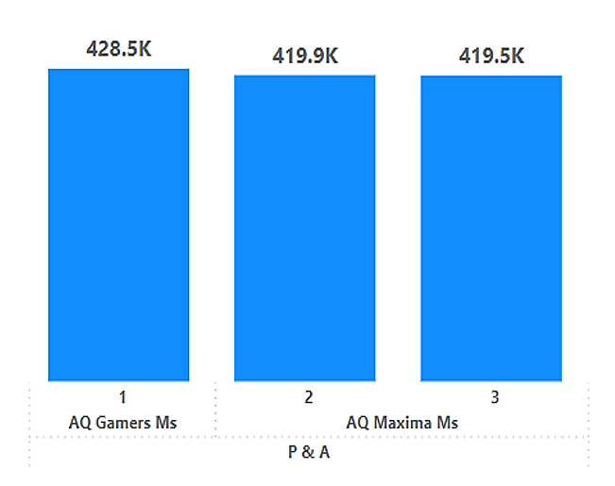
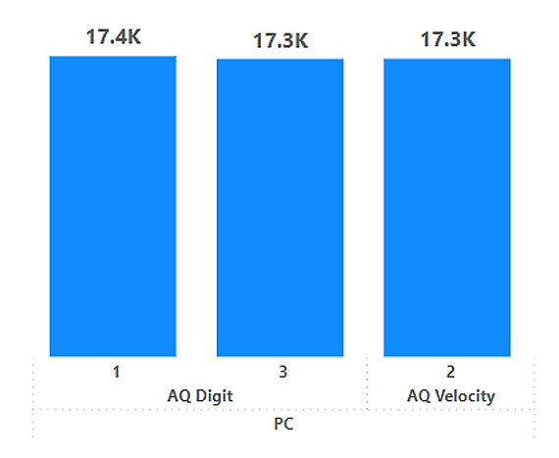
Visual and insights
Pen drives emerged as the top-selling products & collectively reaching a total sales volume of approximately 700,000 units, making them the top three performers.
Mouse emerged as the top-selling products & collectively reaching a total sales volume of approximately 400,000 units, making them the top three performers.
Personal Laptop emerged as the top-selling products & collectively reaching a total sales volume of approximately 17,000 units, making them the top three performers.

Slide 20
Thank you

